Slide 1
Project 1, UNC AI Bootcamp
Assessment of Mental Health in Tech
Team: Connor McCall, Jim Carson, Lou Canjar, Natasia McLean

Slide 2
Project and Data Overview
Project Overview: assess attitudes towards mental health in tech
Data source: Mental Health in Tech Survey, 2014
Mental Health in Tech Survey (kaggle.com)
Preliminary questions:
What are the predictors of mental health issues?
What data values have the most variance in terms in terms of responses?
Are companies that offer mental health support more or less likely to support freedom to talk about health issues?
Does the percentage of respondents in treatment vary by total population, remote workers and self-employed?

Slide 3
Data Cleansing & Correlation Analysis

Slide 4
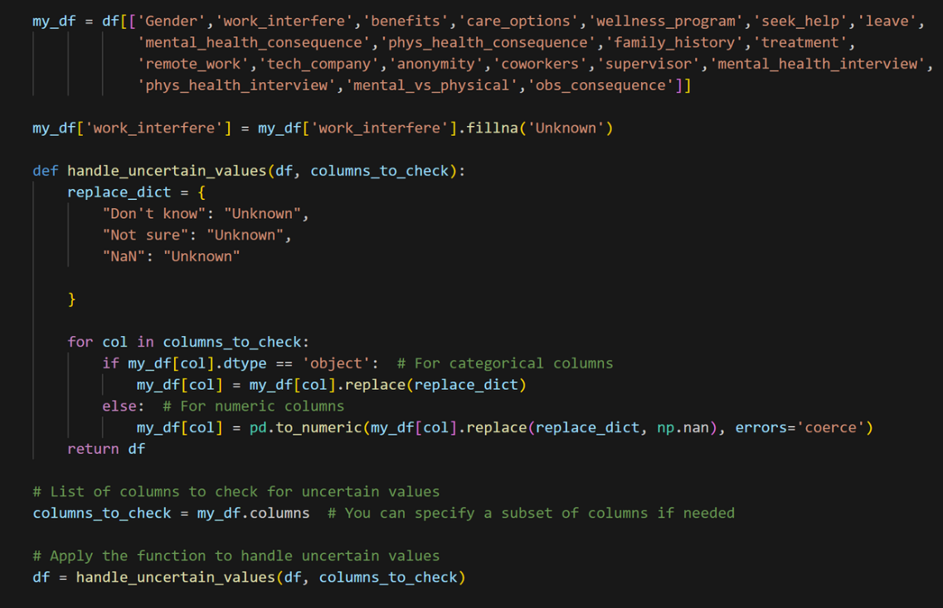
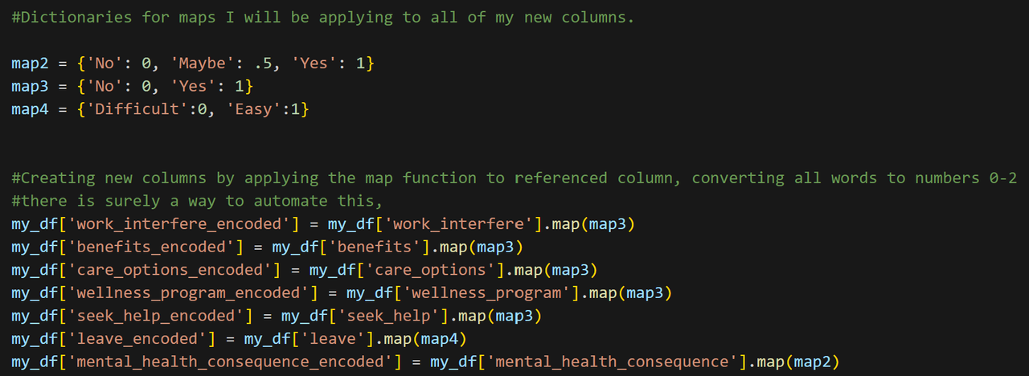
Data Cleaning & Formatting
Key challenges:
Creating uniform values: several responses contained freeform text
Converting Yes, No values to numeric values
Processed columns stored in “my_encoded_df” for correlation analysis

Slide 5
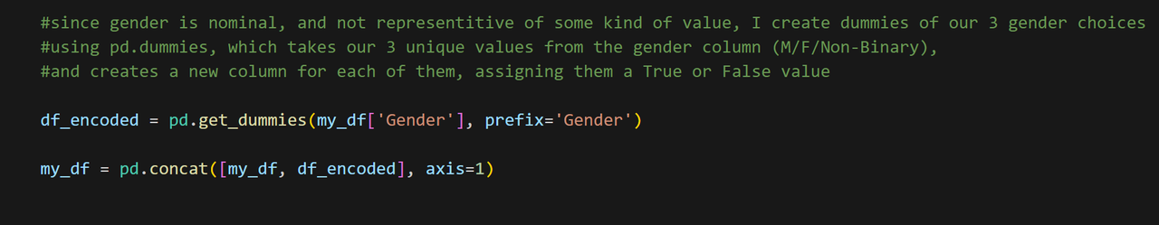
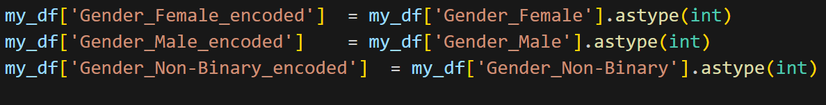
Special Case for handling Gender responses
Using pd.get.dummies for “gender” column
Responses provided were unique relative to other data values

Slide 6
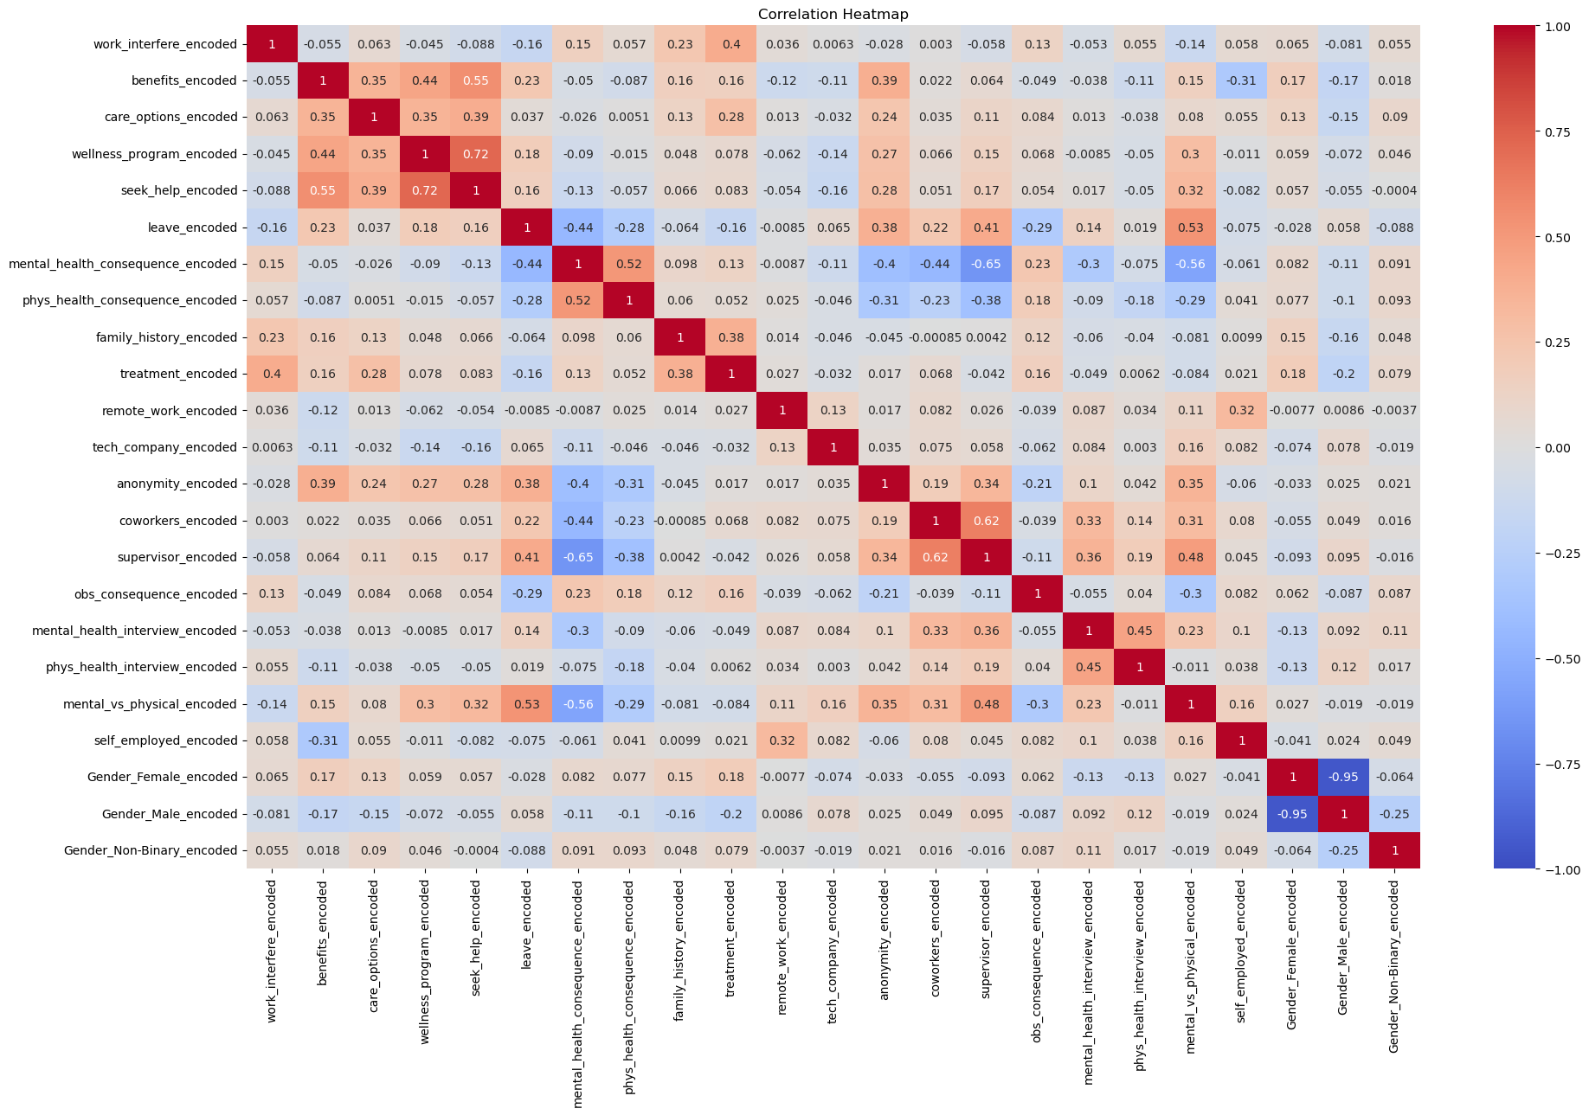
Correlation Matrix
Heatmap – visualizing results

Slide 7
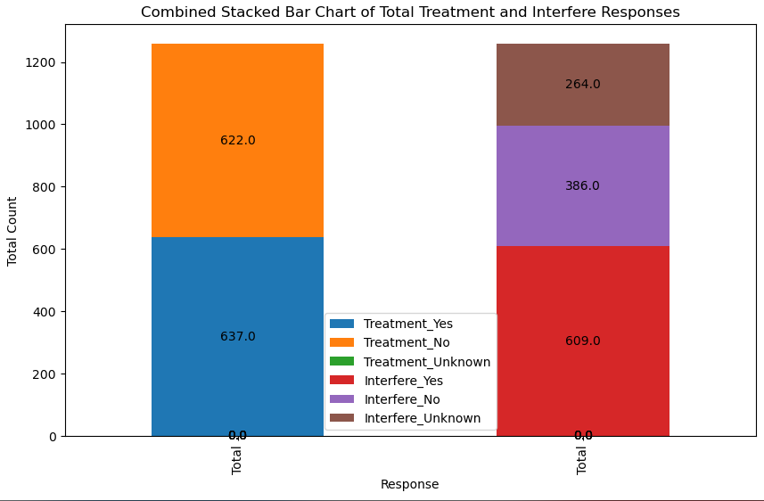
Initial Observation: positive correlation of +0.40 suggest those who feel mental health condition interferes with work are more likely to seek treatment
Initial correlation analysis focused on two dimension:
Work Interfere: “If you have a mental health condition, do you feel that it interferes with your work?”
Treatment: “Have you sought treatment for a mental health condition?”
Observation:
Limited correlation between survey results as predictors of mental health

Slide 8
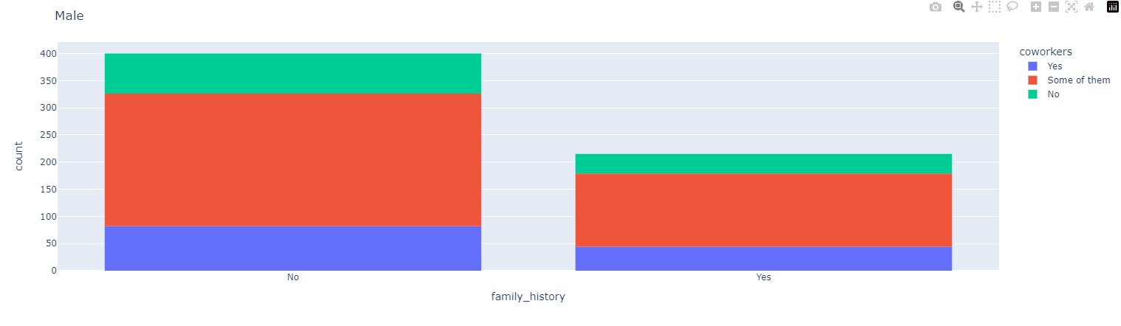
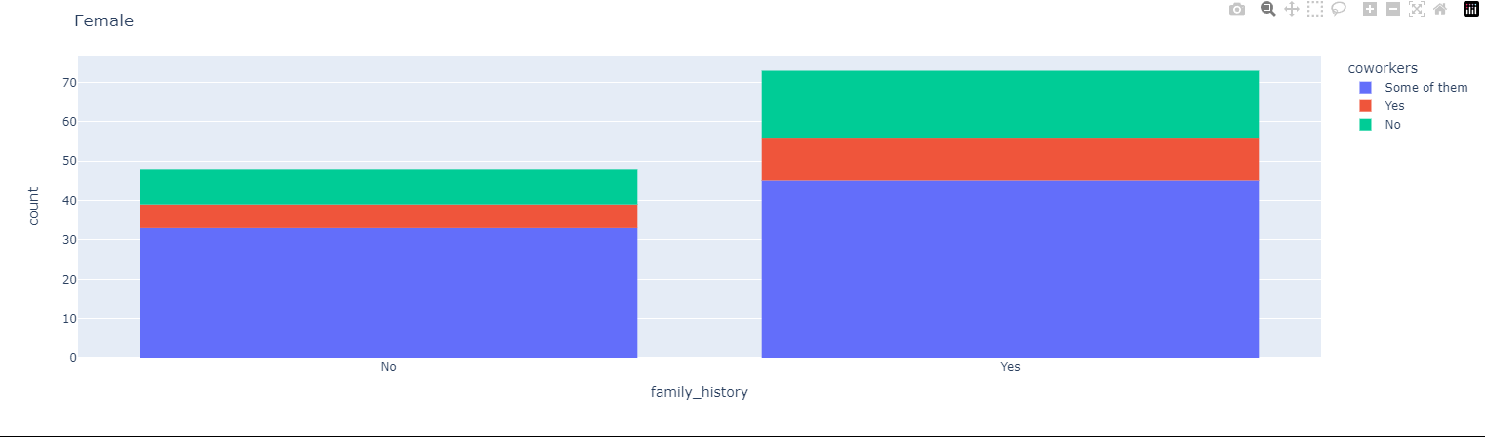
Keying in on family history and demographics
.38 correlation between family history and work interfere (mental health)
Relationship between family history and willingness to talk to coworkers about it, by sex:
No significant correlation, regardless of sex

Slide 9
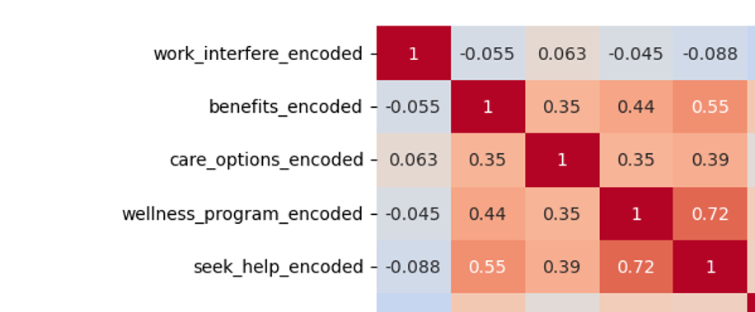
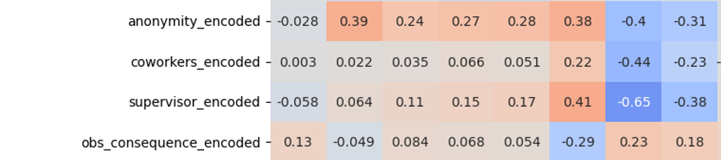
Assessing strong correlation between employers, coworkers/supervisors, and mental health
Heatmap helped highlight clusters of correlation:
Employer benefits, care options, and openness (coworkers/supervisors) showed positive correlation
Also, fear of punishment and willingness to talk about condition showed positive correlation

Slide 10
Analyzing Correlation Patterns

Slide 11
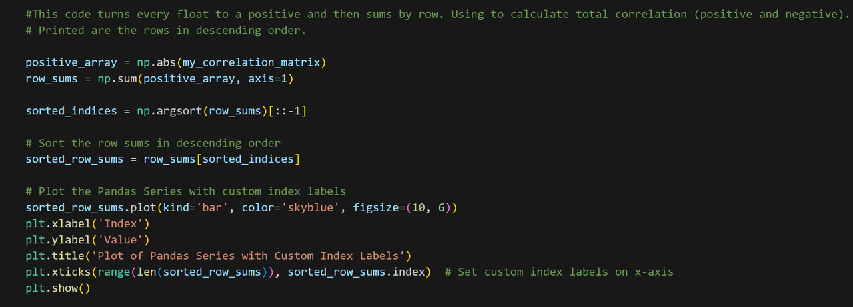
Investigating absolute value of correlation data points (both positive and negative)
Determine total variance for each column

Slide 12
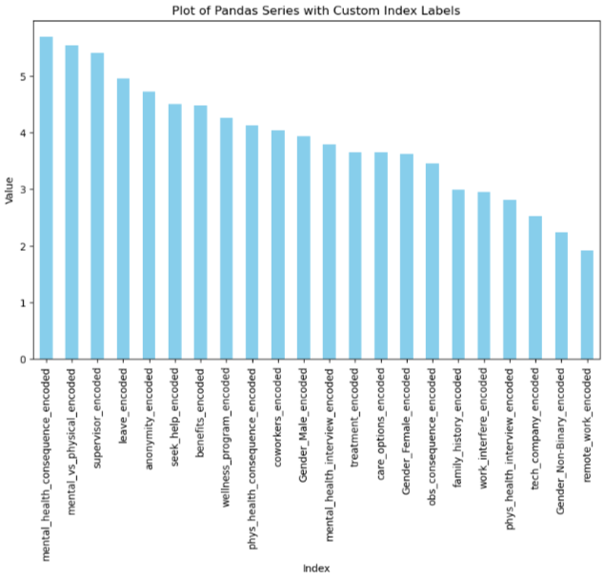
Observation:
Mental health consequences showed strong relationship with trust in employer
This suggests that while trust in the employer might seem a minor aspect of mental health at work, it significantly impacts various related factors
The "leave“* column showed positive correlations with trust factors and negative correlations with distrust factors
* “leave” indicates how easy it is to take vacation

Slide 13
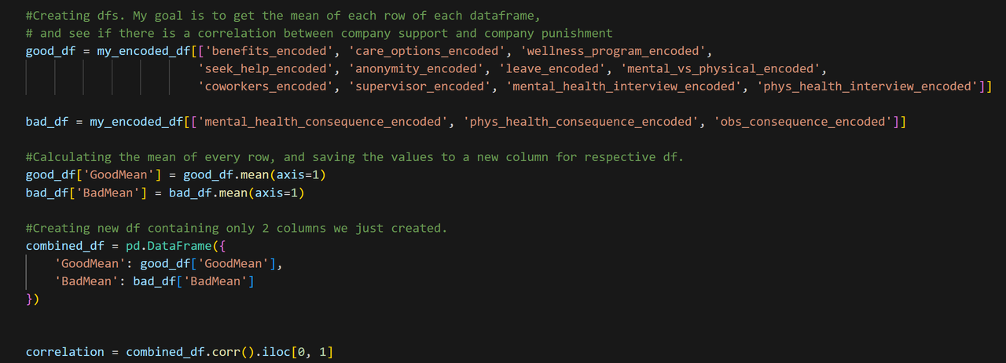
Further Examination
Using a cluster approach, examined:
Perceived “good” values (e.g., company support) vs. perceived “bad” values (e.g., fear of punishment)
Calculate mean of each survey participant yielding a “good score” and “bad score”
Combined results and ran correlation analysis

Slide 14
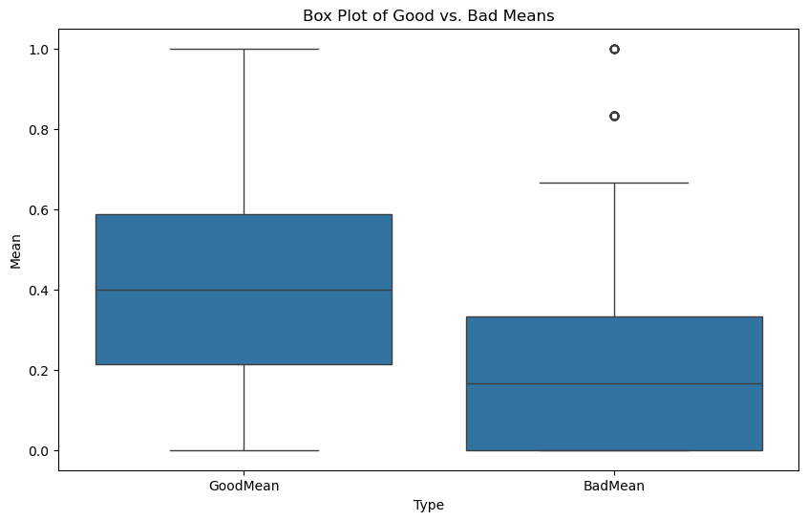
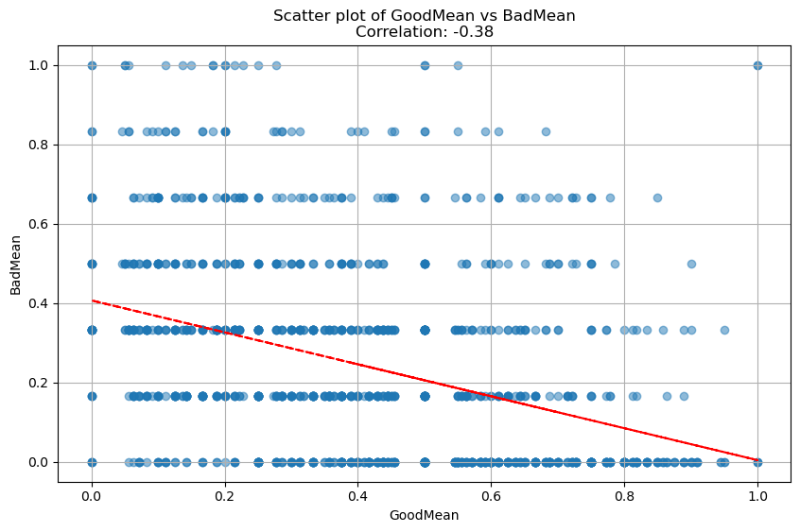
Observation: .37 correlation suggests companies more likely to punish employees for discussing mental health are less likely to provide support.
Relationship between the average of GoodMean and BadMean:
Box Plot: bad mean score lower; good mean more centrally distributed
Scatter Plot:
Employees expecting punishment are often at companies that do not support mental health
Trendline infers employees anticipating punishment more like to work for companies with inadequate support

Slide 15
Other Observations

Slide 16
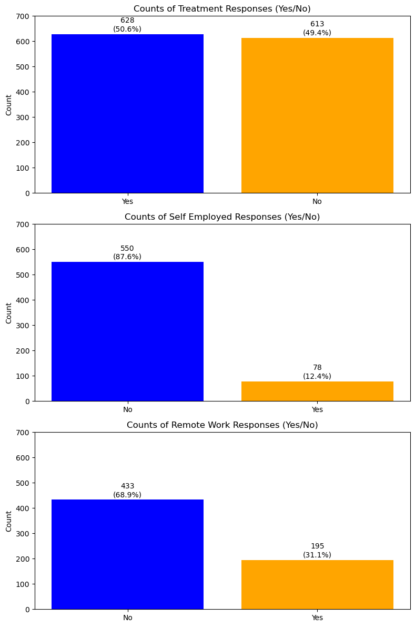
Does % of respondents in treatment vary by total population, remote workers and self-employed?
While no clear indication of causation / correlation, it does imply that remote workers and those self-employed tend to either be less predisposed to counseling or less in need of counseling
And for self employed respondents, benefits may be an issue with a -31 correlation.

Slide 17
Summary and Q&A

Slide 18
Summary
Exercise helped the team employ cleaning and analytics skills learned to-date
Limited “high” correlation between survey responses
Observations/inferences do not imply causation
Teamwork was key to discovering areas of focus and analysis

Slide 19
Questions?

